Slide 1
Obstacle Avoiding Robot
CHETHAN
4nm19me025@nmamit.in
Link to project

Slide 2
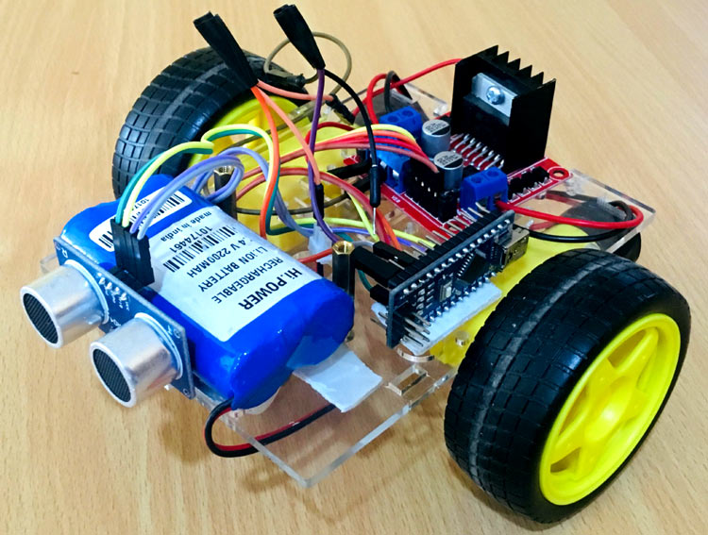
What is obstacle avoiding robot ?
An intelligent device, which can automatically sense and overcome obstacles on its path.
Obstacle Avoidance is a robotic discipline with the objective of moving vehicles on the basis of the sensorial information.
In these cases, the surroundings do not remain invariable, and thus the sensory information is used to detect the changes consequently adapting moving.

Slide 3
Components Involved
Name | Quantity | Component
U1 | 1 | Arduino Uno R3
M1, M2, M3, M5 | 4 | Hobby Gearmotor
PING1, PING2, PING3, PING4 | 4 | Ultrasonic Distance Sensor
U2, U3 | 2 | H-bridge Motor Driver

Slide 4
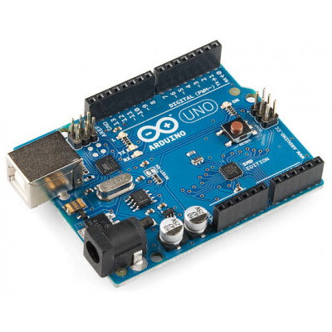
Arduino UNO
Arduino Uno is based on the microcontroller ATmega328P which has a flash memory of 32 kB
The board is equipped with sets of digital and analog input/output (I/O) pins that may be interfaced to various expansion boards (shields) and other circuits
The board has 14 digital I/O pins (six capable of PWM output), 6 analog I/O pins, and is programmable with the Arduino IDE ,via a type B USB cable.
It can be powered by the USB cable or by an external 9-volt battery, though it accepts voltages between 7 and 20 volts

Slide 5
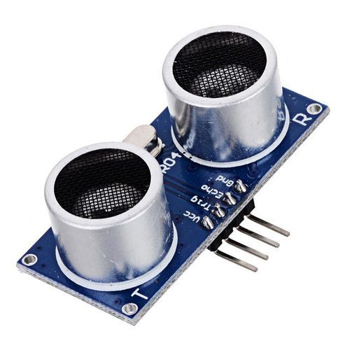
Ultrasonic sensor
Short range distance sensor
Ultrasonic sensors measure distance by transmitting pulses of ultrasonic sound-waves which propagates through the air
If there is an object in front of the sensor, the sound-waves reflects and returns to the receiver
Reflected wave is received by the sensor when there is an object in front of them

Slide 6
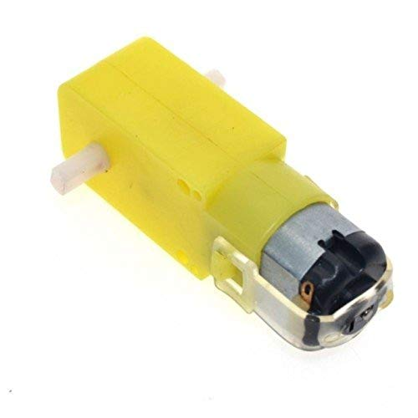
DC motor with gear drive
DC motors are those class of rotary electrical motors that converts direct current (DC) electrical energy into mechanical energy
Parts are armature, stator
The rotating part is the armature which is connected to the DC supply and stator is a stationary part
The armature coil consists the commutators and brushes
The commutator converts the AC induces in the armature into DC and brushes transfer the current from rotating part of the motor to the stationary external load

Slide 7
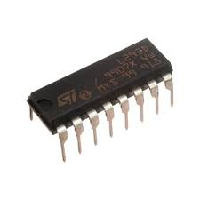
MOTOR DRIVER(L293D)
A motor driver is an integrated circuit chip which is usually used to control motors
Motor driver act as an interface between Arduino and the motors
The most commonly used motor driver ic’s are from the L293 series such as L293D, L293NE, etc.
These ICs are designed to control 2 DC motors simultaneously.
L293D consist of two H-bridge, circuit for controlling a low current rated motor
It is designed to provide bidirectional drive currents of up to 600-mA at voltages from 4.5 V to 36 V

Slide 8
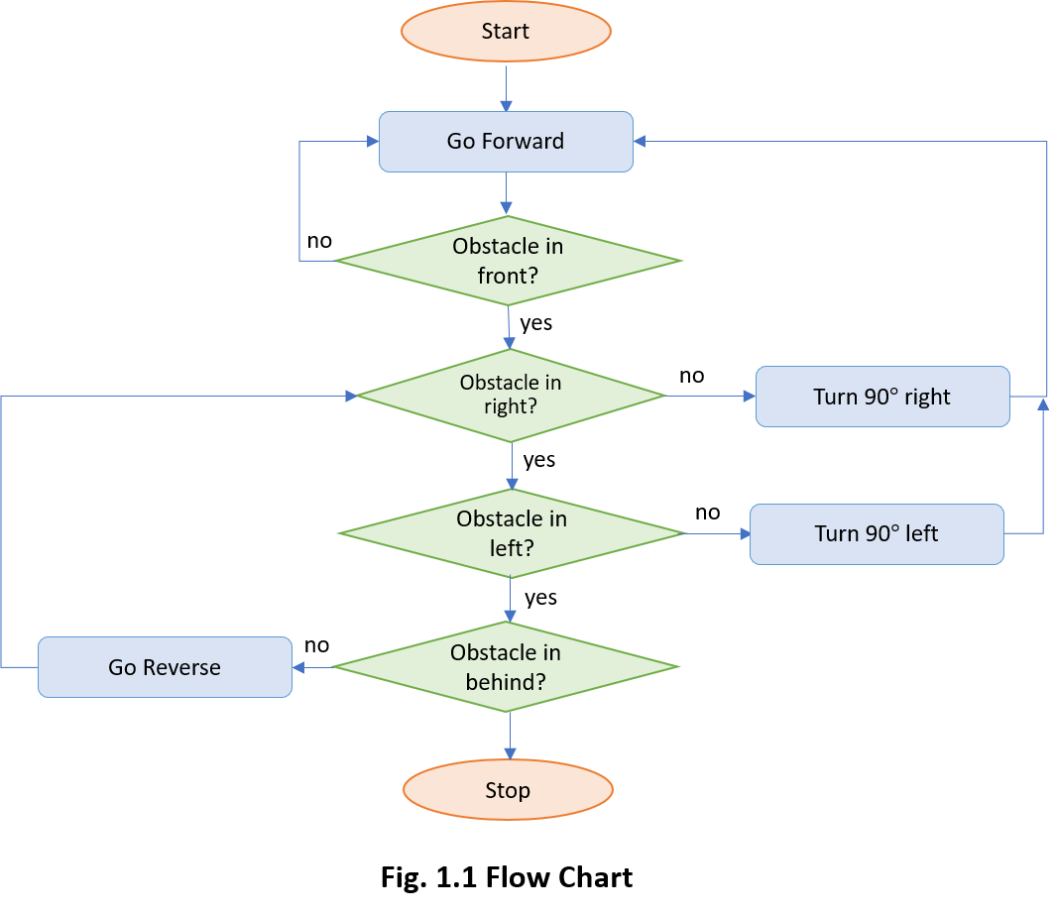
Code and algorithm

Slide 9
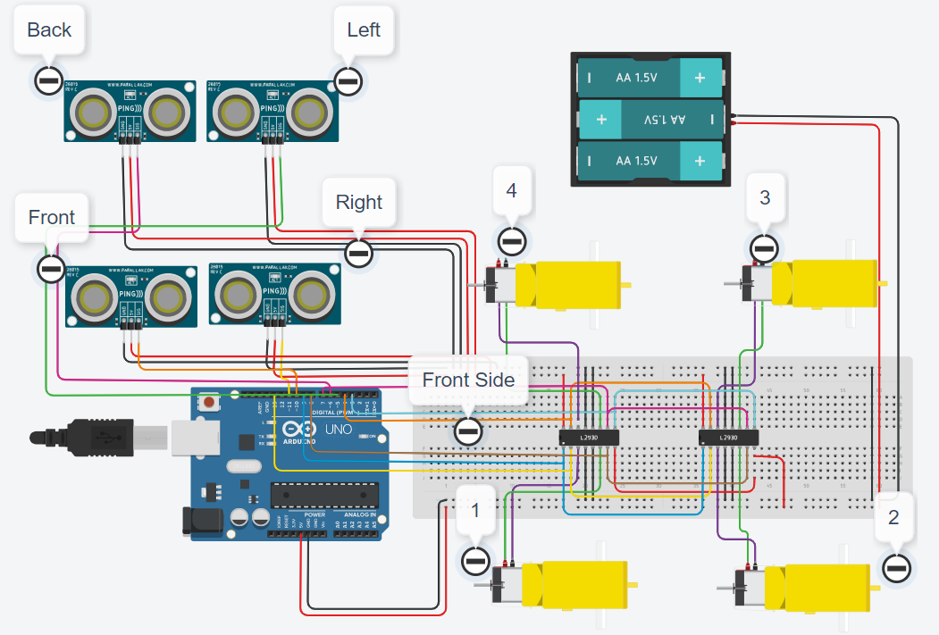
Circuit

Slide 10
THANK YOU

